Slide 1

Tracking
CS 498VR: Virtual Reality
UNIVERSITY OF ILLINOIS AT URBANA-CHAMPAIGN
Eric Shaffer

Slide 2
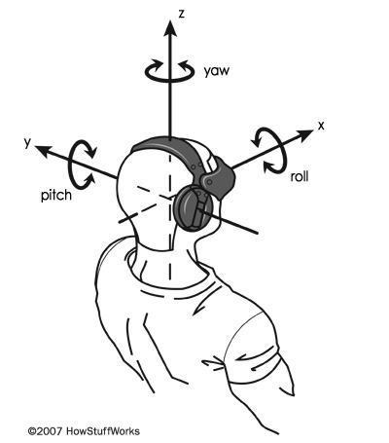
Tracking Systems in VR
Keeping track of motion in the physical world is a crucial part of any VR system.
Tracking was one of the largest obstacles to bringing VR headsets into consumer electronics,
Highly accurate tracking methods have been mostly enabled by commodity hardware components
inertial measurement units (IMUs)
Cameras
These have plummeted in size and cost due to the smartphone industry
Notes:
Encourage people to think of things? Some examples are on the next slide

Slide 3
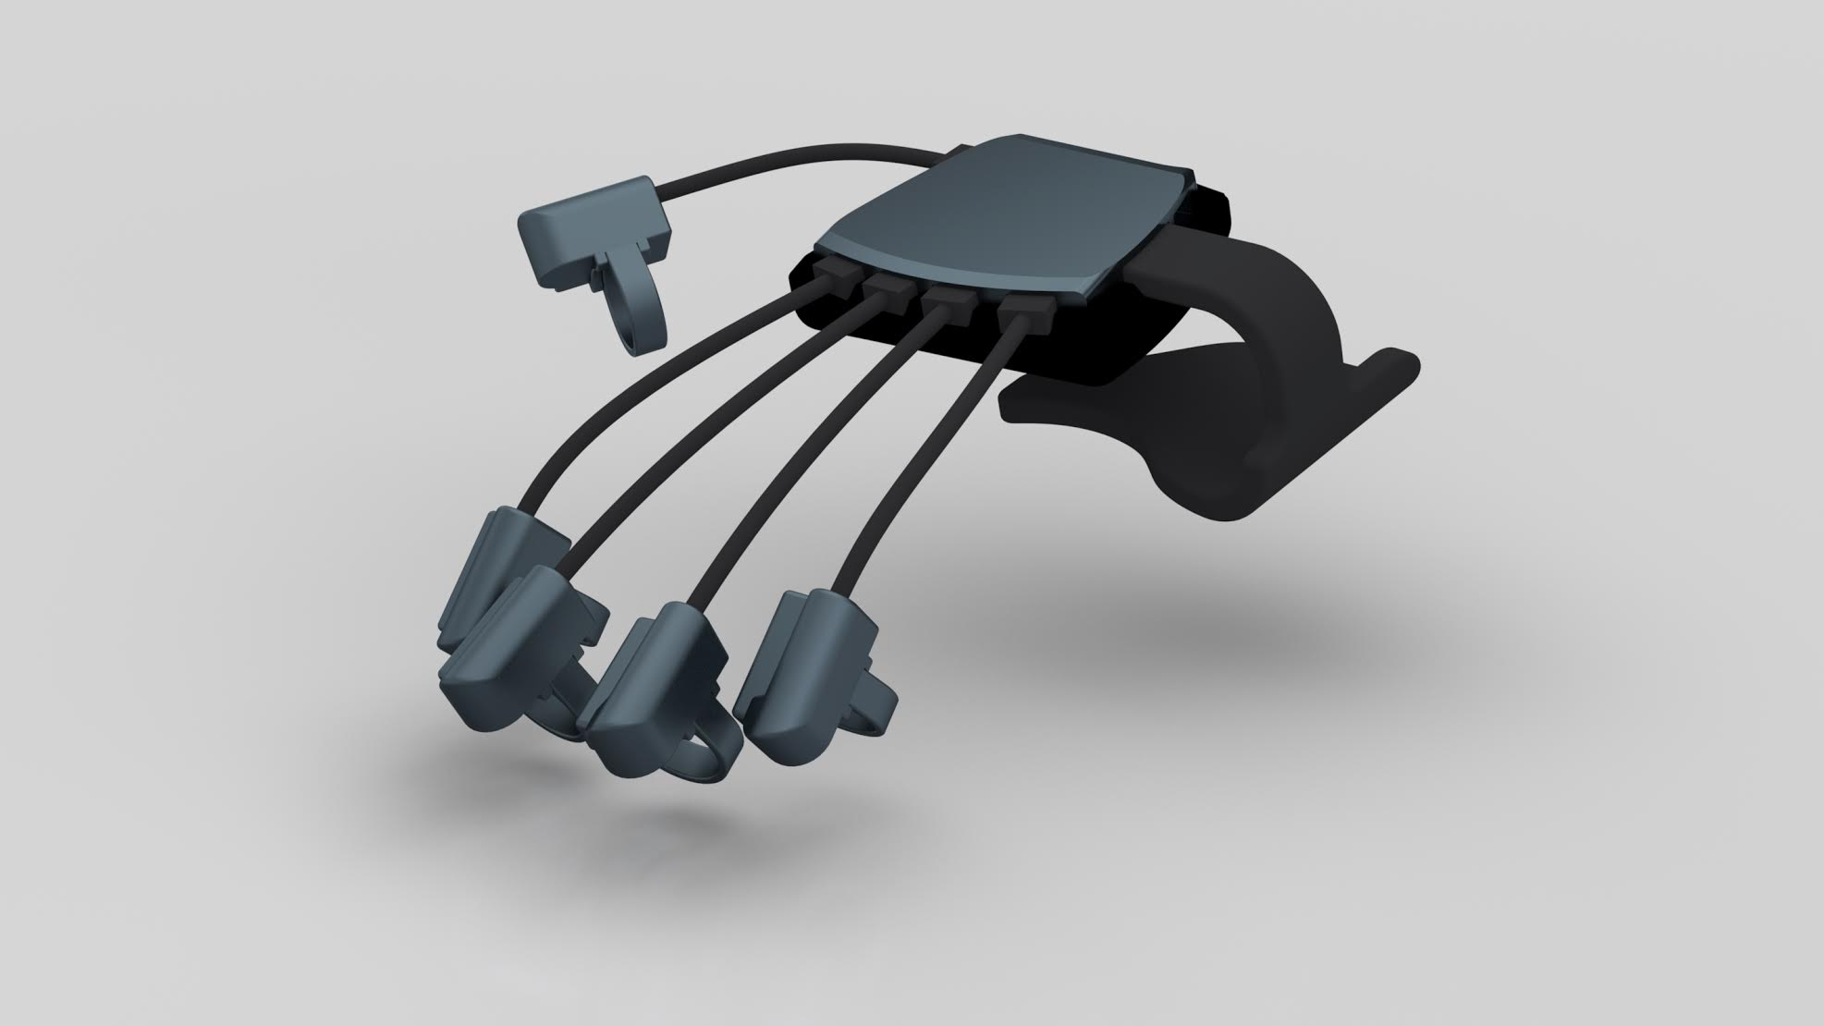
Things We Would Like to Track
What do we want to track? (Think of rigid bodies)
Head wearing HMD
Eyes
Palms of hands
Fingers
Entire body
Interactable objects - controller, coffee cup, desk...
Other people in the space
Notes:
“Entire body” as composed of rigid bodies -- track each individual body part to form the whole body

Slide 4
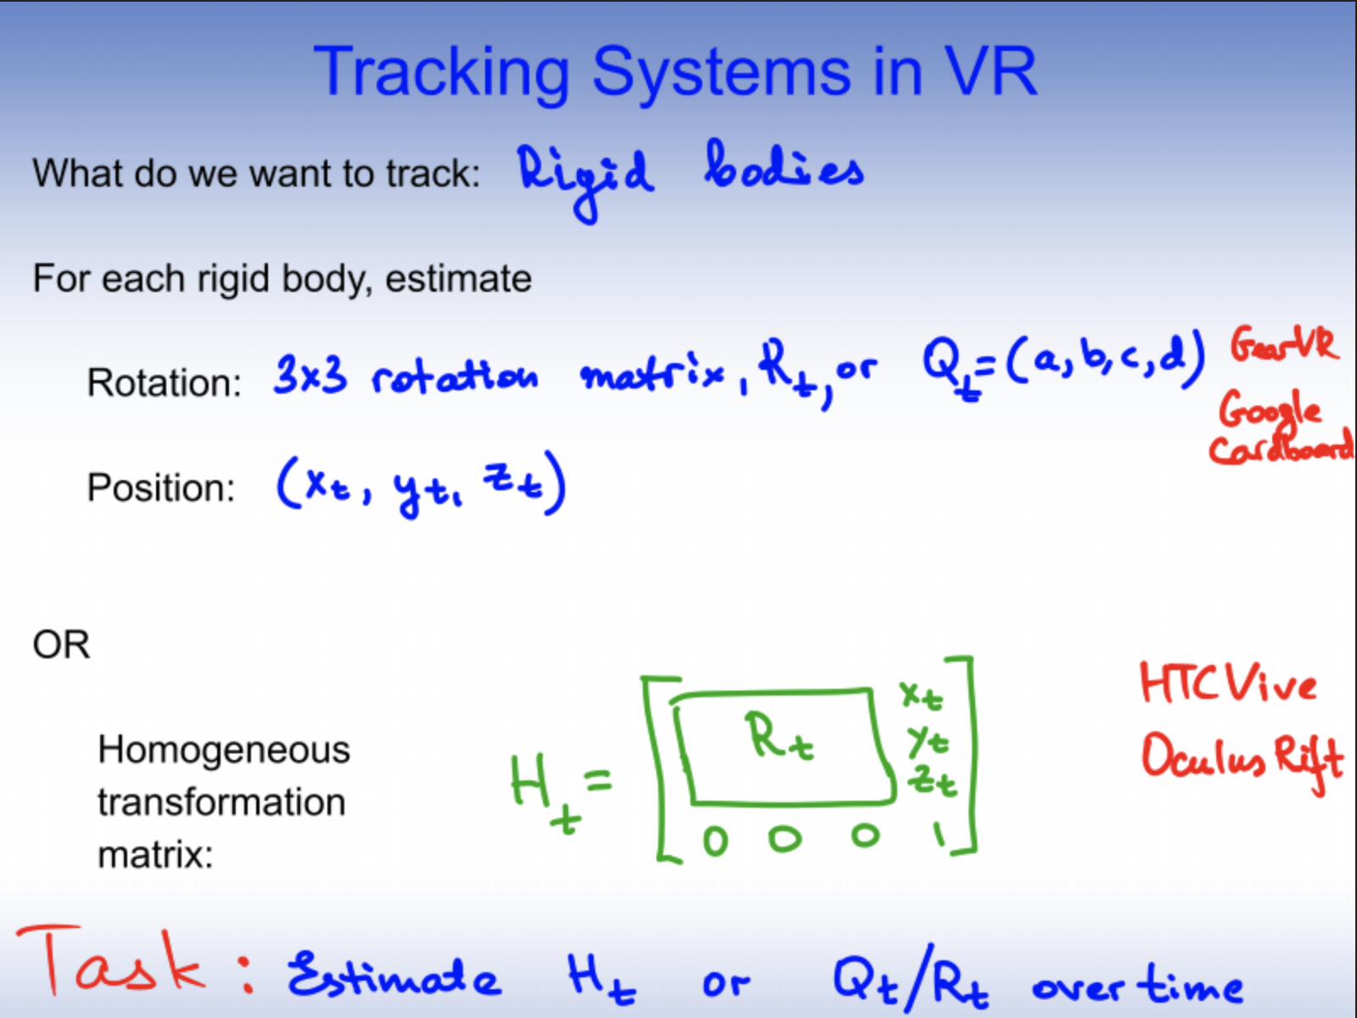
Tracking Systems in VR
What do we want to track?
For each body, estimate:
Rotation:
Position:
Equivalently,
Homogeneous Transformation Matrix (H_{i})
Notes:
This should be review! Rotation could be a 3x3 rotation matrix, or a quaternion (a,b,c,d). Position is (x,y,z)
Homogeneous rotation matrix is a 4x4 matrix, with the rotation matrix on the top left and the last column being [x, y, z, 1]

Slide 5
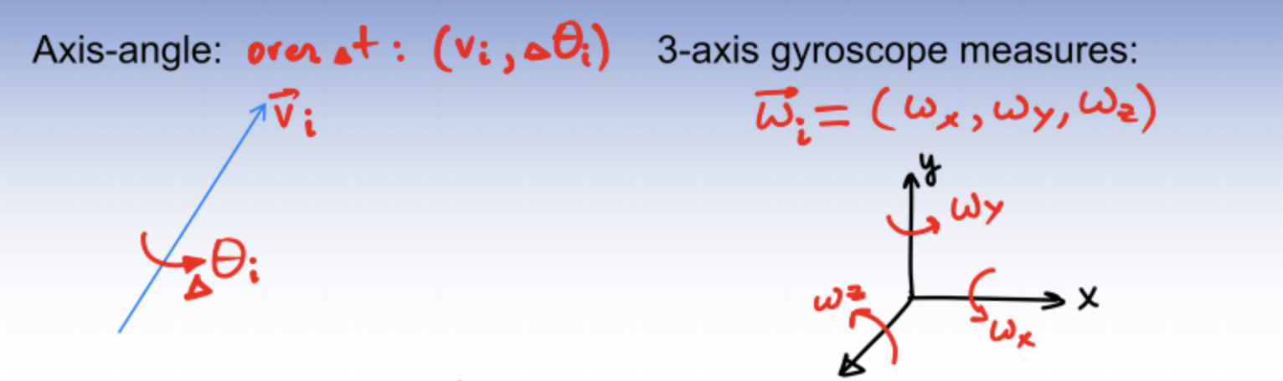
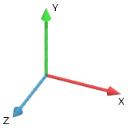
Tracking Systems in VR: Estimating 3D Orientation
Axis-Angle:
3-axis gyroscope measures:
v_{i}
y
x
z
For every Δt, measure ⍵_{i}, and your new rotation is θ_{i} = ⍵_{i} · Δt + θ_{i-1}
Issue: Drift (or dead reckoning)
Notes:
\omega_i is the current angular velocity, \theta_i is the orientation of the object at a time i
Dead reckoning -- comes from sea navigation, as the process of calculating one’s position off a previously known position https://en.wikipedia.org/wiki/Dead_reckoning. Time to get the pirate hat on!
Axis figure from http://www.codinglabs.net/article_world_view_projection_matrix.aspx.

Slide 6
Estimating 3D Orientation: Drift Correction
Defining drift error: divergence of the current estimate from the actual value
Correcting drift error:
Use another sensor (or sensors) to provide a global reference
Gradually apply corrections
Fast enough to eliminate error
Slow enough to avoid VR sickness
Notes:
Drift error: divergence of the current estimate from the actual value
Use another sensor (or sensors) to provide global reference (or a point of reference)
Fast enough to eliminate error
Slow enough to avoid VR sickness

Slide 7
Estimating 3D Orientation
Separate rotational drift into two components:
Tilt error: yaw + roll
To correct: you need a gravity (or “up” sensor)
Yaw error:
To correct: you need a “compass”
- Complementary Filters on SO(3), Mahoney, 2008
- Head Tracking for the Oculus Rift, IEEE International Conference on Robotics and Automation 2014, S. LaValle, A. Yershova, M. Katsev, M. Antonov
Notes:
Tilt error: yaw + roll
To correct: you need a gravity (or “up” sensor)
Yaw error: to correct: you need a “compass”

Slide 8
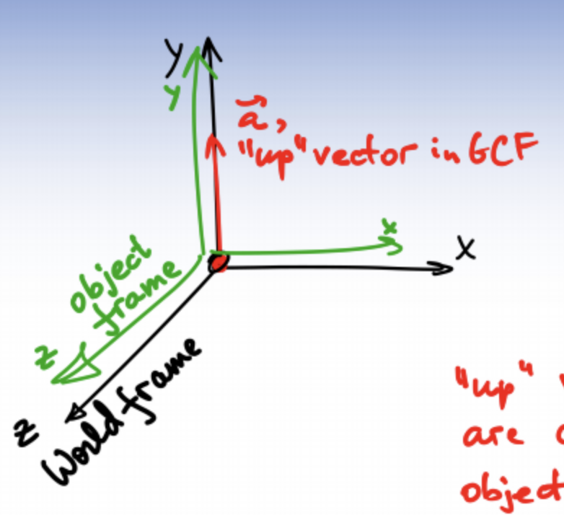
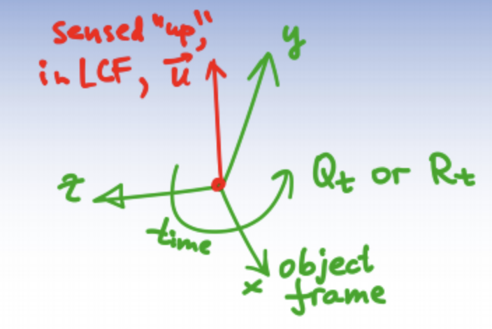
Use “Perfect Up” Sensor to Correct “Tilt Error”
If estimated Y-axis is not aligned with measured up-vector, apply transformation to estimate to correct error.
Global Coordinate Frame
Local Coordinate Frame
y
y
x
z
z
x

Slide 9
Use “Perfect Up” Sensor to Correct “Tilt Error”
Find difference between estimated “up” and measured “up”.
Gradually apply transformation. (Also known as complementary filter)
Profit.
Local Coordinate Frame
y
z
x
Notes:
As much as you might not want to, think about MP2! Similar to disabling rotation.
δ = a・y⁻¹ (where a is the measured global up vector and y is the estimated up-vector (aka y axis in local coordinate frame))
Objective: Rotate everything in the scene by δ.
Apply it in small increments to avoid VR sickness (due to jitter or other unnatural movements),
but still fast enough to correct the error imperceptibly.

Slide 10
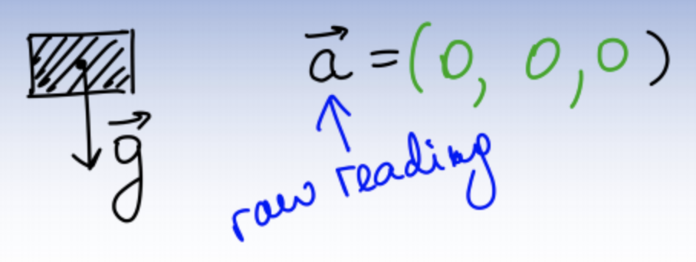
Using Accelerometer as “Up” Sensor
What do accelerometers measure?
If device is in free fall?
Notes:
They measure a 3-vector of acceleration of the device

Slide 11
Using Accelerometer as “Up” Sensor
What do accelerometers measure?
If device is in free fall? (hint: or in outer space)
Notes:
Measures (0,0,0)

Slide 12
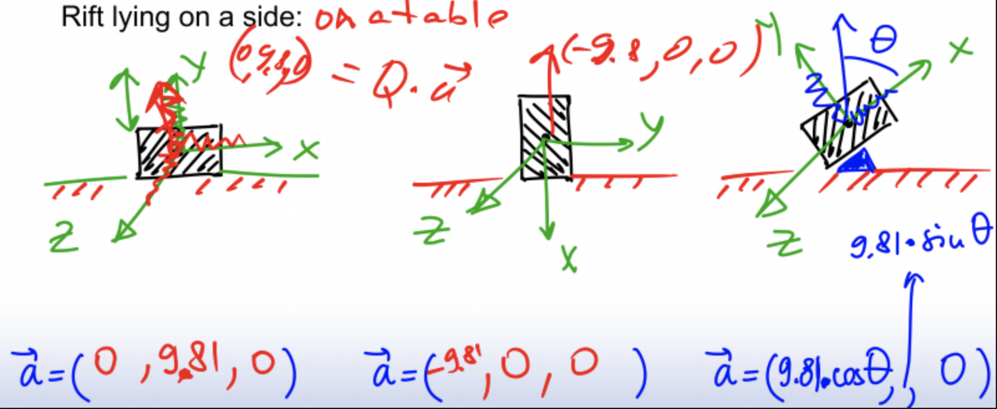
Using Accelerometer as “Up” Sensor
What do accelerometers measure?
If device is in free fall? (hint: or in outer space)
Lying still on a table?
Notes:
No matter what the orientation, the magnitude of the vector measured is 9.8 m/s^2

Slide 13
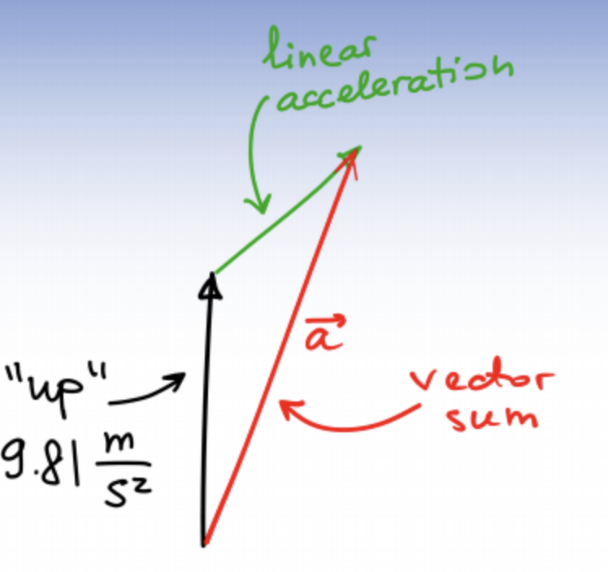
Use Accelerometer to Correct Tilt Error
Problem:
Accelerometer measures vector sum of linear acceleration of the sensor and gravity.
Solution:
Use heuristic to detect when “not moving” and apply correction only then.
Notes:
White arrow: “up” ≈ 9.81 m/s^2; green arrow: linear acceleration; red arrow: vector sum.

Slide 14
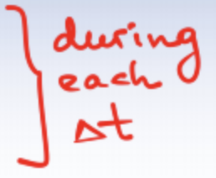
Use Magnetometer to Correct Yaw Error
Similar to tilt correction:
Calculate reference error
Gradually apply using complementary filter
Problems:
Vector sum of Earth’s magnetic field + ambient interference (building structure, electronics nearby, etc.) + the device’s electronics itself
The field strength will vary over time and space!
Generally, accurate to ≈ 5º
Notes:
Vector sum of Earth’s magnetic field + ambient interference (building structure, electronics nearby, etc.) + the device’s electronics itself
The field strength will vary over time and space!
Generally, accurate to ≈ 5º

Slide 15
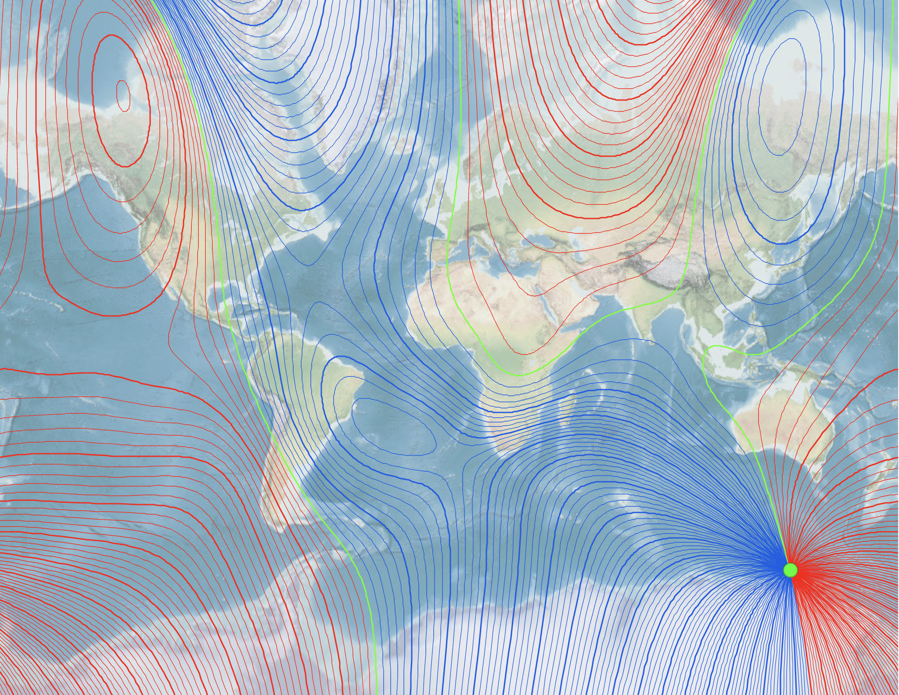
Notes:
To give a sense of how inaccurate magnetometers can be: This is a map of the earth’s magnetic declination, which is the angle between the force of the earth’s magnetic field and the geographic north pole. Notice how much it varies geographically. This makes magnetic sensors hard to calibrate, especially without an internet connection.
From NOAA: https://maps.ngdc.noaa.gov/viewers/historical_declination/

Slide 16
Estimating Position and Orientation
The Problem:
Allow and track parallax motion (translations)
IMU (accelerometer + gyroscope + magnetometer) is not enough
Drift errors too fast and no good way to detect
Need: high accuracy and stability
Solutions:
Generate own EM signal
Visibility or line-of-sight methods
Notes:
IMU = inertial measurement units
High accuracy = sub-millimeter
Stability = no drift errors
Solutions usually combine the two of these:
e.g. oculus head tracking and touch, Vive, wii remote

Slide 17
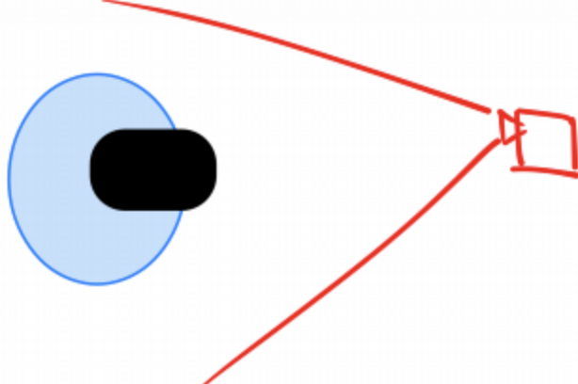
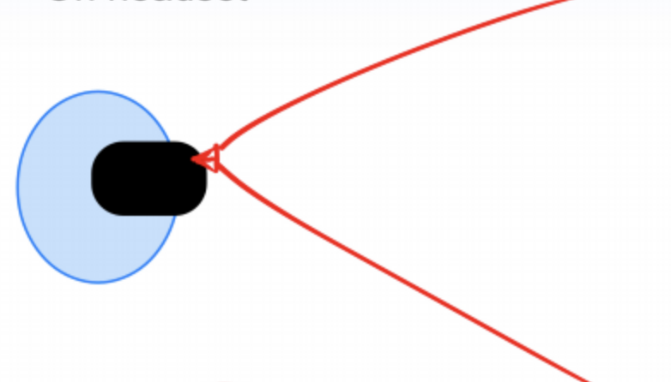
Position Tracking: Visibility Methods
Camera arrangements:
On headset
In world
inside-out
outside-in
Notes:
Inside out -- camera is on headset
Outside in -- camera is outside facing the user
Please forgive my crude figures

Slide 18
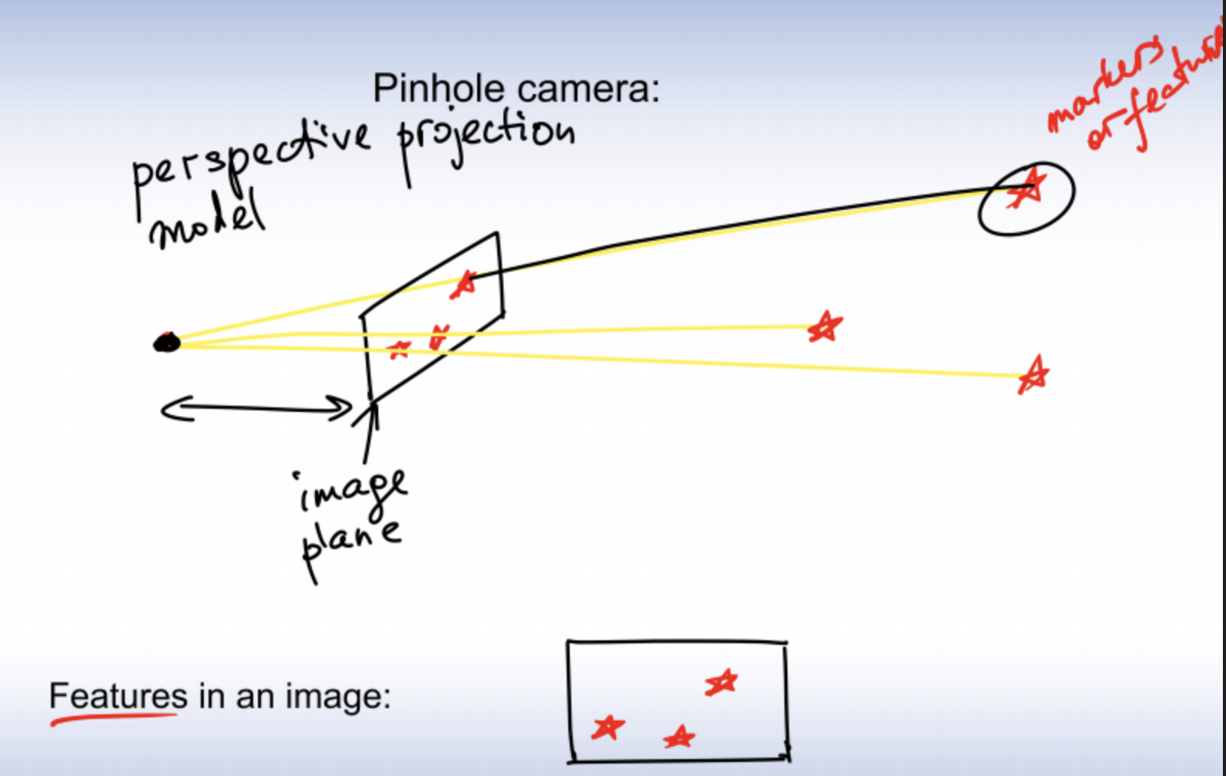
Position Tracking: Visibility Methods
Pinhole camera:
Features in an image:

Slide 19
Position Tracking: Visibility Methods
Natural
Extract and maintain from natural scenes
Ignore moving objects
Hard computer vision problems
Low reliability
Artificial
Use known fixed markers in environment
QR codes, reflective tape, LEDs, lasers
Can stay in IR spectrum
Trivial computer vision
Requires prior knowledge or setup of environment
Notes:
Natural markers rely on looking for stationary, significant objects (read: collections of pixels) in the user’s environment/on the item to be tracked. Examples: HoloLens, Leap motion, Kinect. Not quite consumer-ready for VR.
Artificial: Look for premade markers. Examples: Oculus rift and touch: IR beads on the headset and controllers. Note that IR spectrum is invisible to humans!

Slide 20
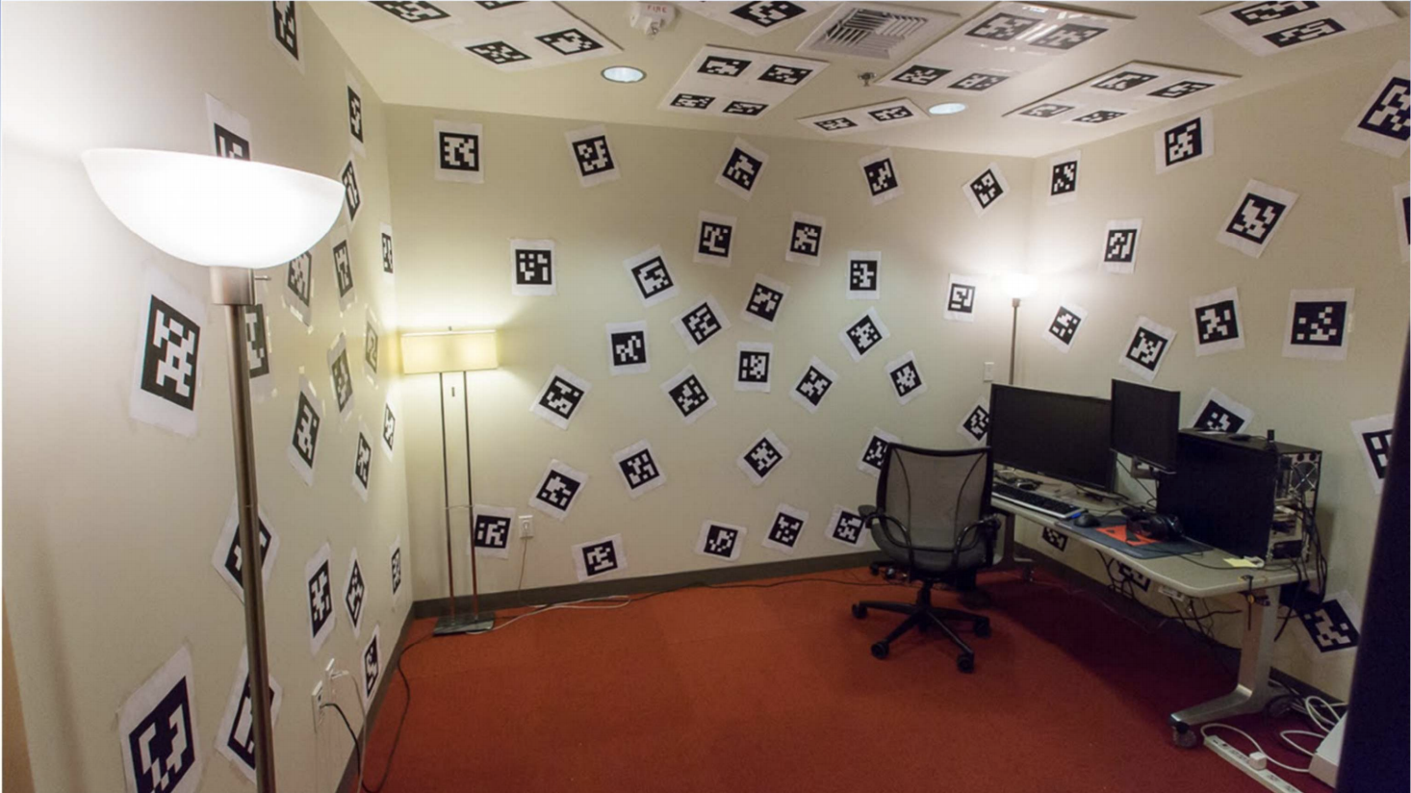
Position Tracking: Inside-Out Tracking
Notes:
Click the image! Valve’s The Lab experience on the Vive contains a homage to the early days of VR development -- when the prototype was made of two cell phones that tracked QR codes plastered over the walls.
https://www.youtube.com/watch?v=itLuNFfrFW0

Slide 21
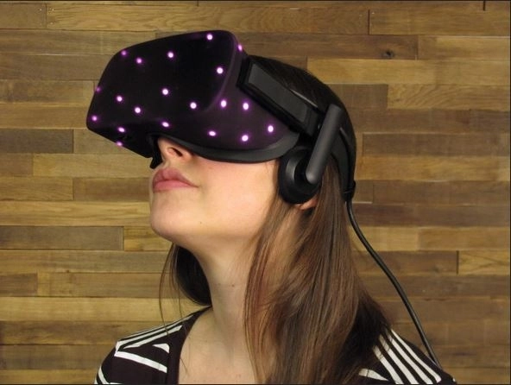
Position Tracking: Outside-In Tracking
Notes:
The oculus rift uses several infrared LEDs under a plastic housing (which is transparent to IR light) which are observed by the camera(s) to accurately track the position and orientation of the headset.
Image credit: iFixit https://www.ifixit.com/Teardown/Oculus+Rift+CV1+Teardown/60612

Slide 22
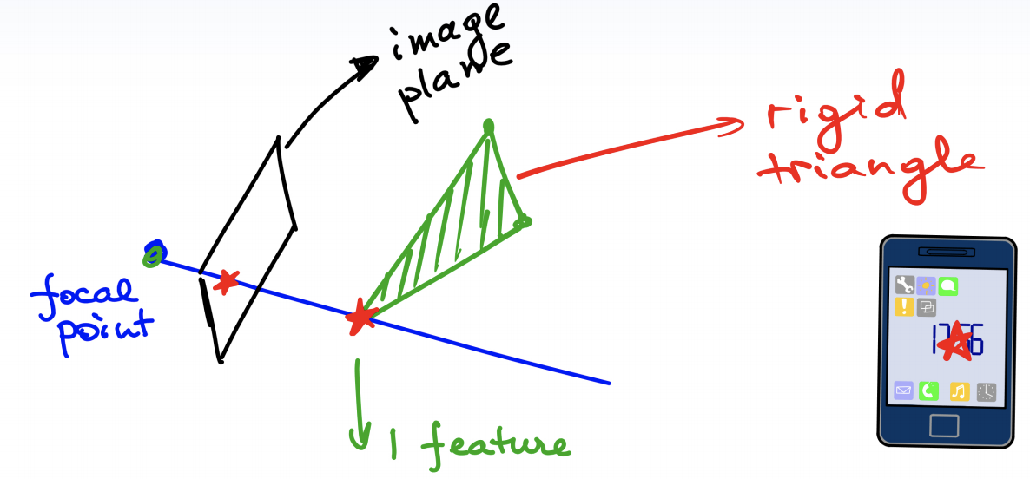
Position Tracking: Blob Detection
PnP Problem:
Determine rigid body transformation from identified, observed features on a rigidbody.
P1P:
DOF Analysis:
Start with 6 unknown DOFs (for a rigid body)
Each feature subtracts 2 DOFs
Notes:
PnP: (Perspective line) (n Points) Problem
For one feature, it identifies the body’s position on the x-y plane, but not its rotation or depth (distance on the z-axis)

Slide 23
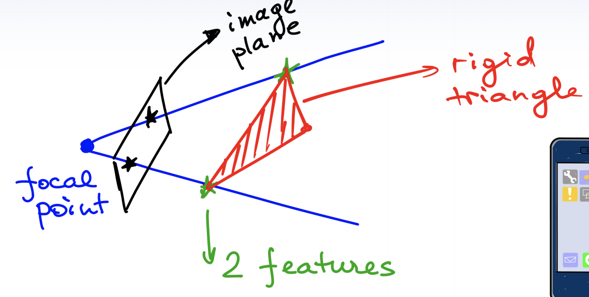
Position Tracking: Blob Detection
P2P:
DOFs left: rotation about X and Y axes
Notes:
Two features: eliminate position, rotation about Z axis. Unknown: rotation about X and Y axes

Slide 24
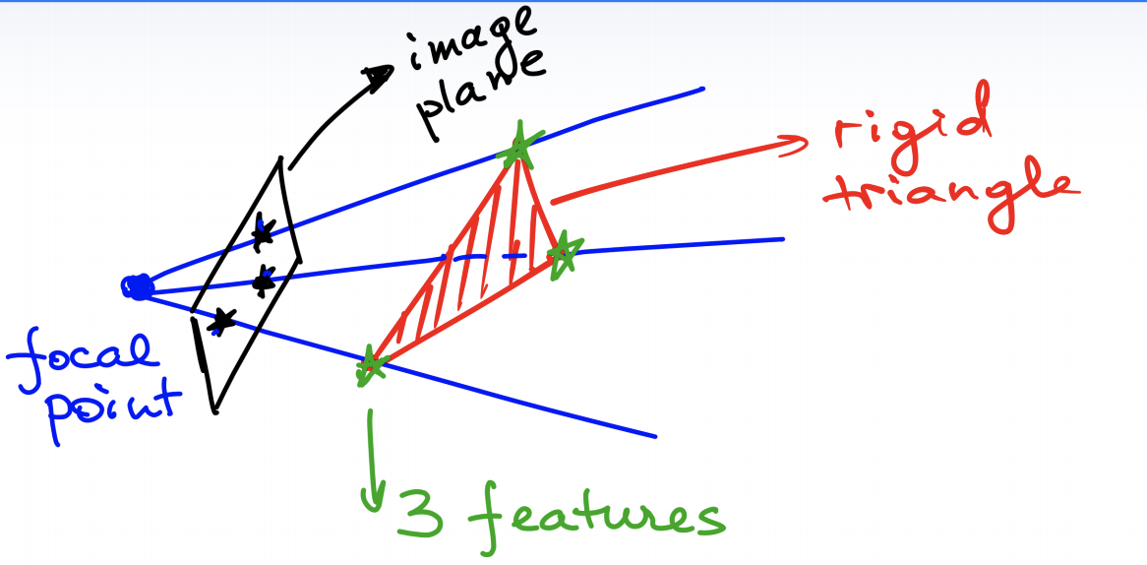
Position Tracking: Blob Detection
P3P:
DOFs left:
Notes:
With three features per rigidbody, the thing’s position and orientation are known (assuming the positions of the three features relative to each other are known)

Slide 25
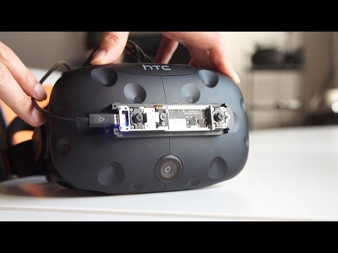
Inside-Out Tracking

